Slide 1
Calval toolbox proposal - Philosophy
Toolboxes should be run for each site independently, munging each PT and each drift individually
Someone who was on the water should run the scripts to set the parameters
All field names of I/O must be standard across sits
To be run on the UMass cluster via NENS access
Produces dataframes of reach and node averaged quantities
All intermediate products available- fully reversable

Slide 2
Calval toolbox proposal - Overview
I have working scripts that:
1. QA/QC PTs with user defined knobs (duplicates Shailen's processing?)
2. Correct drifts to PT levels based on a space-time filter and SWOT obs time/level
3. Calculate wse within nodes*
4. Calculate wse within reaches*
5. Extract lidar wses within reaches*/nodes*
6. Calculate slope from wses
I plan on making scripts that:
7. classify aerial imagery and calculate extent within reaches*/nodes*
*I define the nodes and reaches in these scripts from SWORD

Slide 3
Inputs to the toolboxes
Key files to link PTs, Drifts, lidar, airphotos in space and time from field notes at each site: On Tuesday, drift ID xxx passed PTs a,b,c
This makes the table joins trivial rather than searching through all drifts and all PTs to find those that are coincident
Drift data from Shailen
Via podaac
PT data from Shailen
Via podaac
GNSS level and antenna offset corrected already
Lidar raster from ???
Open to processing points, but much easier to start with raster
Airphoto raster from vendor
Pre geolocated, radio/ortho corrected and etc.

Slide 4
Outputs from the toolboxes
Data frames (in whatever format you want)
Field names flexible
Data are 'tidy'
This means the tables are much larger than they would be if there were separate frames of single variables
Allows total interoperability, joins, and queries
Not 'excel style'
Can split into sub frames if desired by date, time, site, reach, node, etc.
One data frame per file
Can later join them to make a table like this
Node there is a unique set of wses per drift
ReachID | NodeID | Drift_ID | PT_ID | Date time | wse_bar | wse_sd | drift_slope | drift_slope_sd | PT_slope | PT_slope_sd | extent

Slide 5
Looks at a raw PT file and checks to see if either of the ‘QAQC’ or ‘flagged’ folders contain a copy of it so that we can efficiently re-run without manual checking
Joins that raw PT file to a GNSS drift based on a key to associate GNSS drifts with the PTs
Filters for GNSS data within a specified time and distance threshold of the PT set by the user for that particular river
Calculates both a put in and pull out offset between the GNSS and the PT level
Applies those offsets to PTs by closest time- if the offset changed, split the difference
Existing code 1. QA/QC PTs with user defined knobs

Slide 6
Existing code 1. QA/QC PTs with user defined knobs
Applies any field GNSS height offset corrections
Automatically scrubs any leading or trailing out-of-water data
Makes the following checks, all based on user thresholds to be tweaked by river
GNSS standard deviation within the time/distance filter- are the GNSS data too noisy?
GNSS data points- are there enough GNSS observations to make an offset?
Offset consistency- did the PT offset change dramatically from put in to takeout? This indicates settling.
Sudden shifts- are there shifts in the record other than at the beginning and end that indicate getting bumped?
If it passes all the tests, it places the PT with its new heights in the QAQC folder
If it fails, it prints the data and adds a column with an error message that describes why it failed in a ‘flagged’ folder so a tech can look at it
This process duplicates the process Shailen is doing, but with a lot more QA/QC. I will likely keep the checks in step 7 and after but start from step 6 with Shailen's data

Slide 7
Existing code
2. Correct drifts to PT based on a space-time filter
Reads in QA/QCd PTs from above, along with GNSS drifts
Calculates the distance from every GNSS position @ 1Hz to all PTs less than a user defined distance threshold
Calculates the difference between PT level @ SWOT overpass time to PT Level closest to each 1Hz position
Applies an IDW (power 4) to adjust the height of the GNSS based on any number of PTs within range, where each adjustment is time varying based on #3

Slide 8
Existing code
2. Correct drifts to PT based on SWOT time
SWOT is ~instantaneous relative to field data
We take the level of the PTs at the nearest 15 minutes to SWOT's overpass time
The difference between the PT level when the GNSS passes it (at 1hz) and when SWOT was overhead forms an offset
This offset is applied dynamically within the IDW
Therefore, the drift appears to 'bend' as it gets further and further from SWOT overpass time

Slide 9
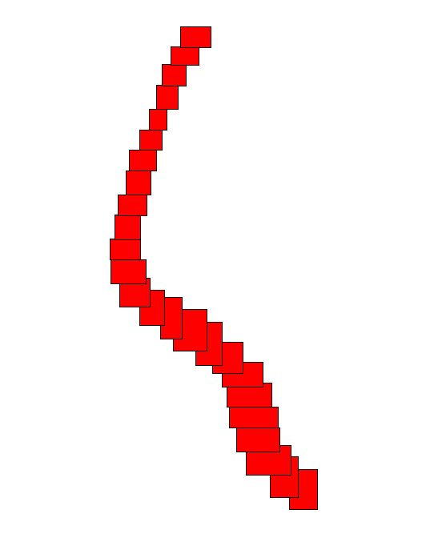
Existing code
SWORD centerline
3. Calculate slope and
wse within nodes:
Average all drift points within
Each red box
Node x,y
node length
Max width
SWORD centerline
Angles determined from SWORD centerline
It doesn't look like an orthogonal because it is bounding boxed. I could also make diamonds on axis, but this seemed better

Slide 10
Existing code
3. Calculate slope and
wse within reaches:
Average all drift points within each reach
SWORD reach 3
Get mask from airphotos/Planet/S2
Get level from PT at image time and store for later comparisons
Very simple process- we have access to masks that SWOT does not
SWORD reach 2
SWORD reach 1

Slide 11
Existing code
5. extract lidar wses within reaches/nodes:
Another straightforward process for us but not for SWOT
SWORD reach 3
SWORD reach 2
SWORD reach 1
Sample lidar raster
Within these polygons

Slide 12
Existing code
6. Calculate slope from wses
JPL defines slope as first to last
We must match this definition in the field
Slope A:
(PT2 - PT13)/ dist(PT2 <> PT 13)
Slope B:
Mean (PT(1,2,3)) - Mean (PT(12,13,14)) /
dist(PT2 <> PT 13)
1
PT
2
3
0.4-1km
Field spacing depends on river
Which PTs included depends
on river
Key file indicates which PTs to use
…
12
13
14
Reach boundary

Slide 13
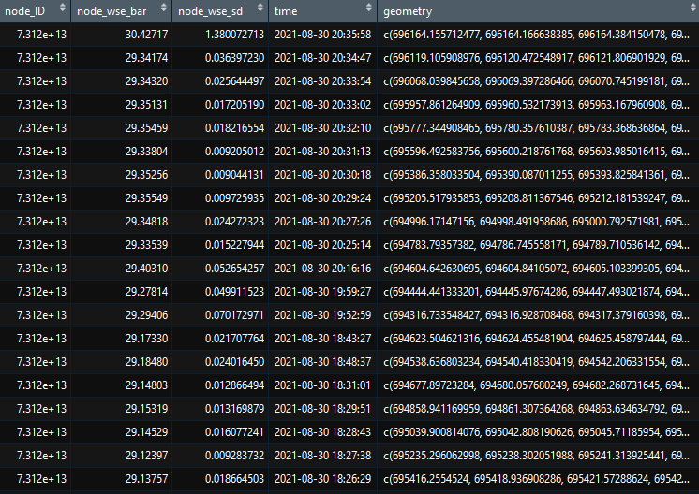
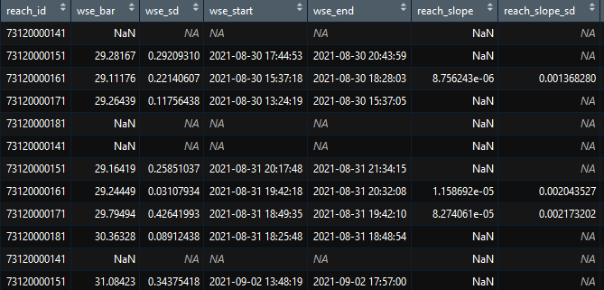
Output example: drifts
Key file makes these fully interlinked

Slide 14
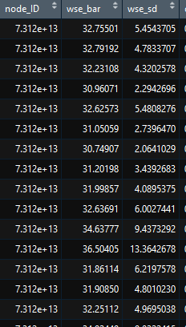
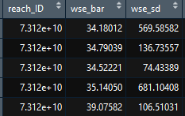
Output example: lidar
Used a polygon that grabbed lidar
from shore: demo only

